Slide 1



Evaluating the Effectiveness of Machine Learning in Storage Systems
Are We Taking the Right Direction?
Rahul Vishwakarma
Bing Liu
Jinha Hwang
California State University Long Beach
Dell Technologies
California State University Long Beach

Slide 2

Background

Slide 3
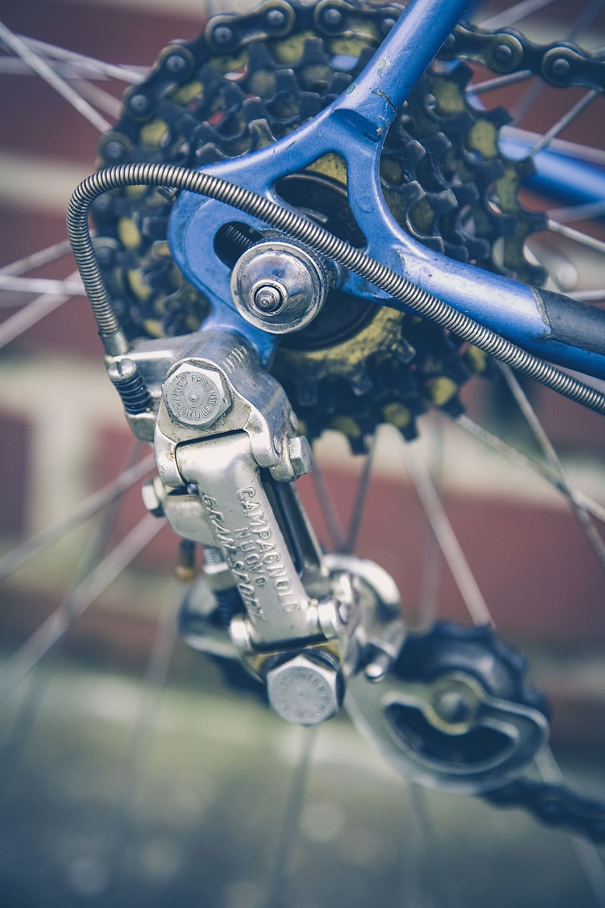

Machine Learning
Model Parameters
Machine Learning Model
Designed by Human
Learned from Data

Slide 4



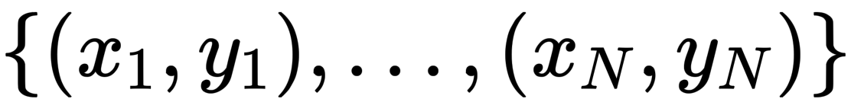
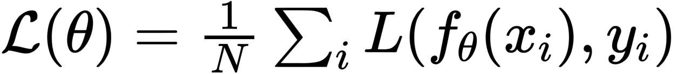
Supervised Machine Learning
Target prediction f(x)
Input (x)
f,
Model of problem
Given a dataset
Pick
that minimizes the Loss

Slide 5
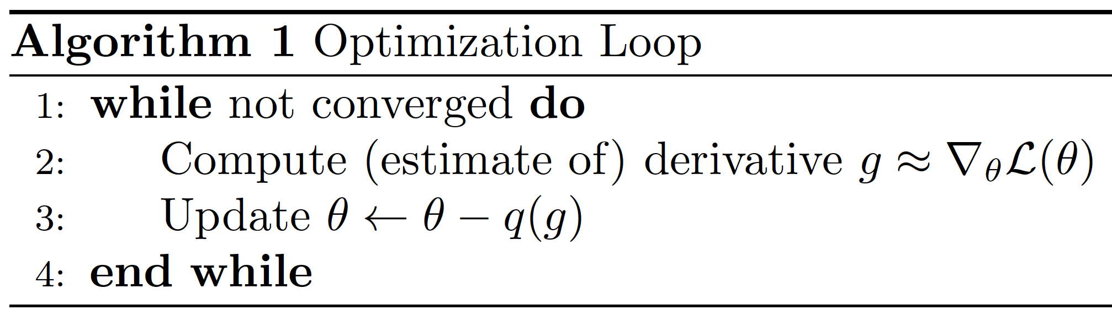
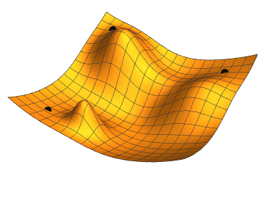
Gradient Descent
Minimize loss function in training set
Use computational method of optimization
Image from Wikipedia

Slide 6
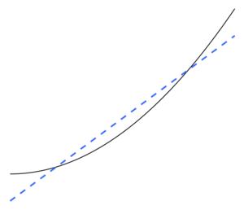
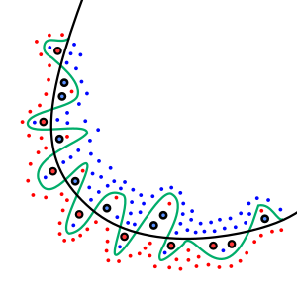
Generalization
Underfitting
Overfitting

Slide 7
Agenda
Machine Learning for Storage
Challenges with Storage Solution
Addressing the Gaps
Perspectives and Use Case
Conclusion

Slide 8
Introduction

Slide 9
Machine Learning for Storage
Motivation
Task
Data Placement Optimizations
cache, prefetching, provisioning
Failure Prediction
disk failure, data corruption
Storage Tuning
IO scheduler, cache sizes
Change & Anomaly Detection
security aspect
Intelligent Storage Devices
maintenance and performance boost

Slide 10
Challenges

Slide 11
Key Challenges
Limited Training Data
Real-time Requirements
Adaptation to Shifting Needs
Complex Cost Models

Slide 12
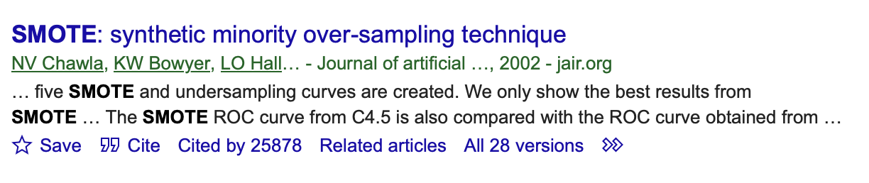
Small dataset
How we handle
Add synthetic data (GAN) and 10 by 10 Rule
Imbalanced dataset (classification)
Synthetic Minority Oversampling TEchnique (SMOTE)

Slide 13
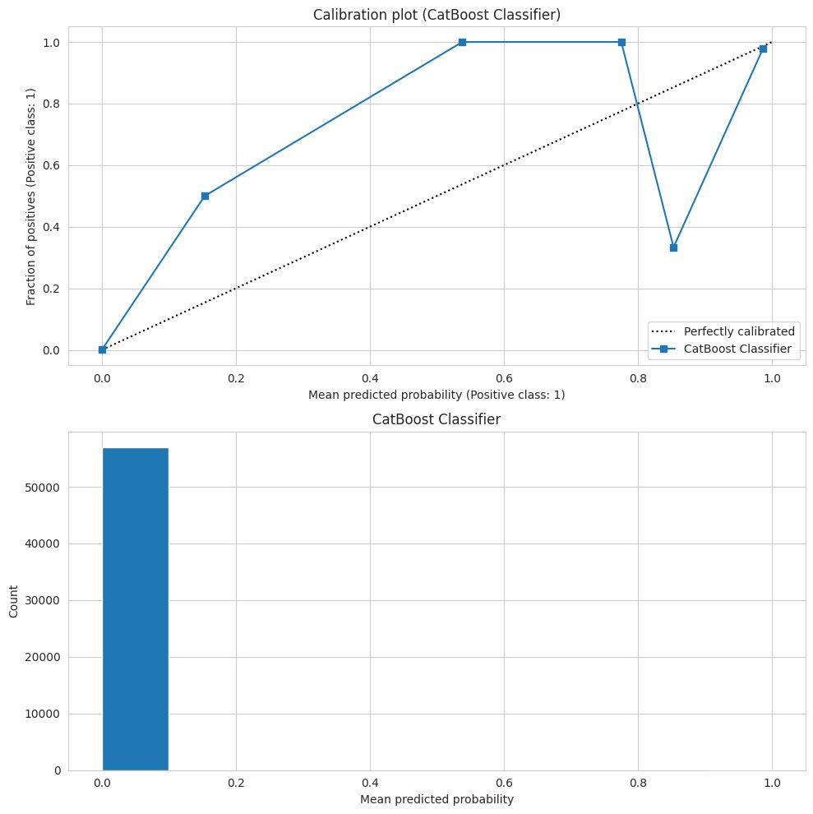
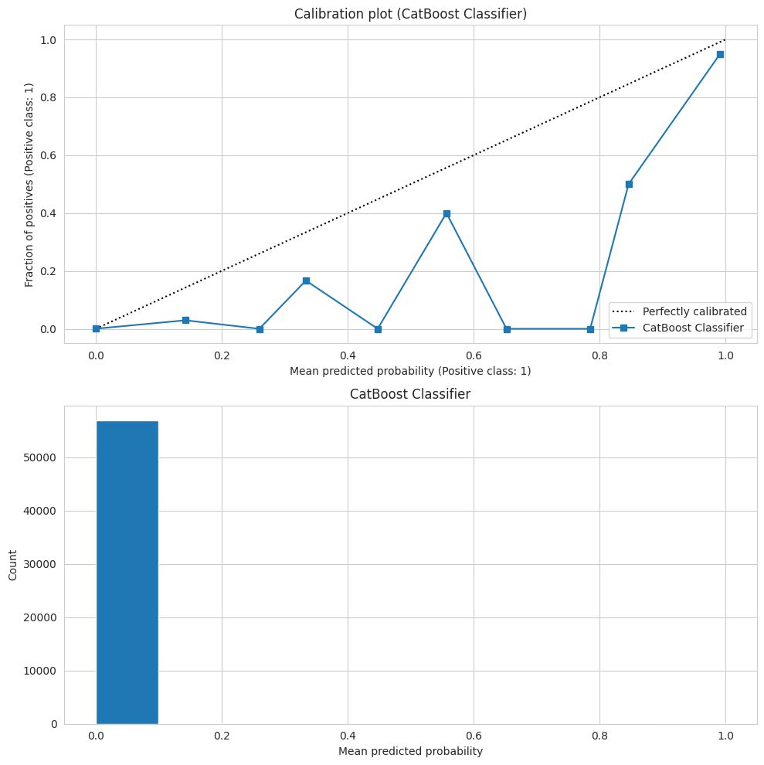
Experimental result
SMOTE has degraded calibration by 200%
Expected Calibration Error before SMOTE 0.0265
Expected Calibration Error after SMOTE 0.0799
https://www.linkedin.com/posts/activity-7109928475876044800-e05R/

Slide 14
Addressing the Gaps

Slide 15
Potential Gaps
Uncertainty-Aware
Explainable
Interpretable
Algorithmic randomness
Trust, Transparency
Bias, Fairness detection

Slide 16
Explainability
SHAP for explaining individual predictions
Permutation feature importance
Partial dependence plots for feature effects

Slide 17
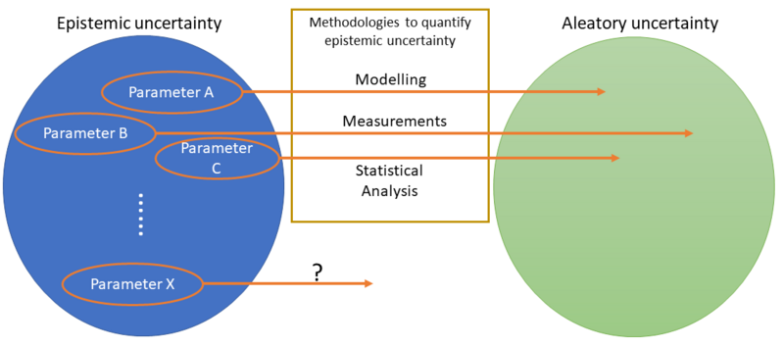
Uncertainty Quantification
Lack of information (model)
Inherent randomness on data

Slide 18
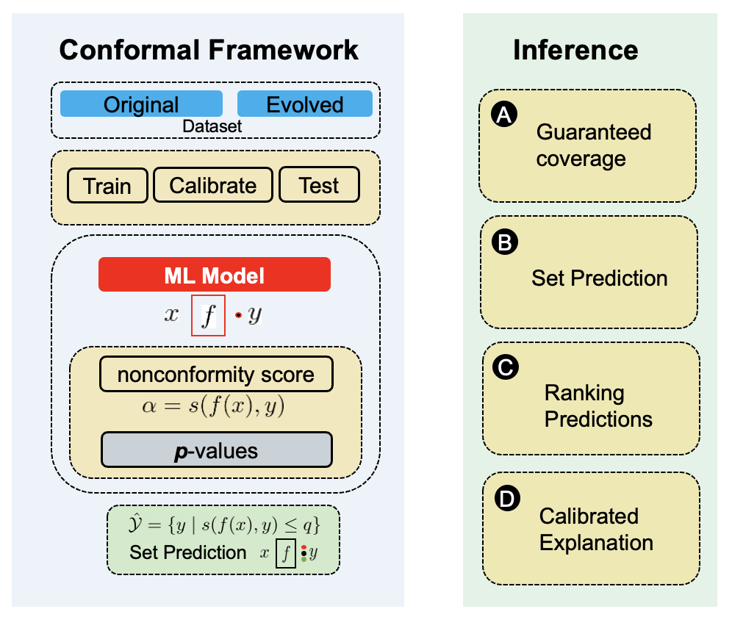
Conformal Prediction
Degree of uncertainty
Can say – “I don’t know”
Metrics for data quality

Slide 19
Interpretability
What is good explanation?
What are we looking for?
Fairness
Privacy
Causality
Trust

Slide 20
Perspectives and Use Case

Slide 21
Possible Use Cases
Data Management
Heath Analysis
Data Scrubbing
Hot Sparing

Slide 22
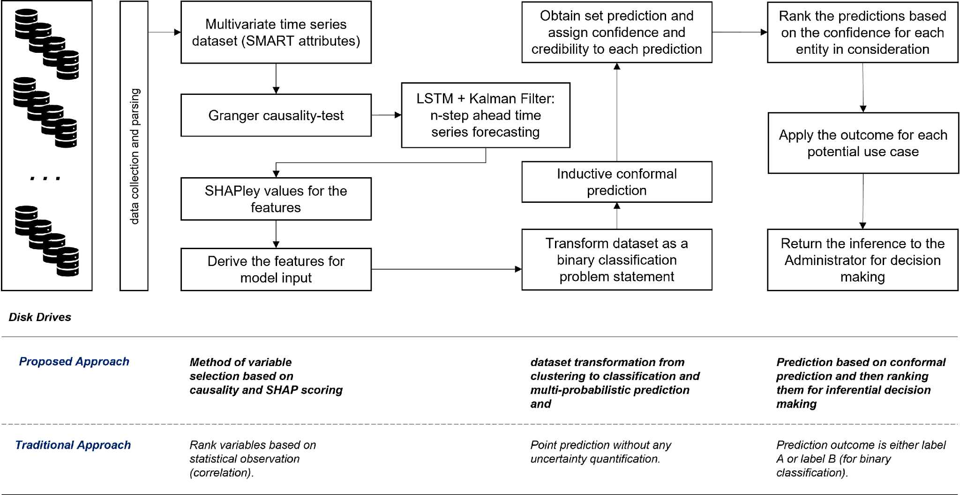
Disk Drive Management

Slide 23
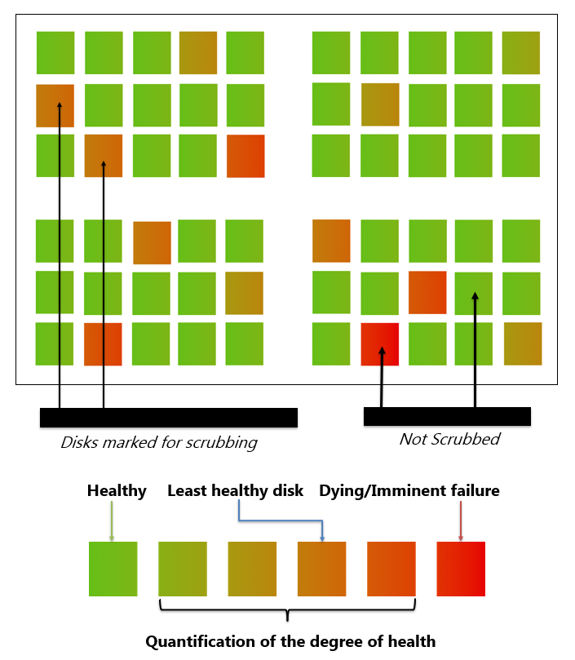
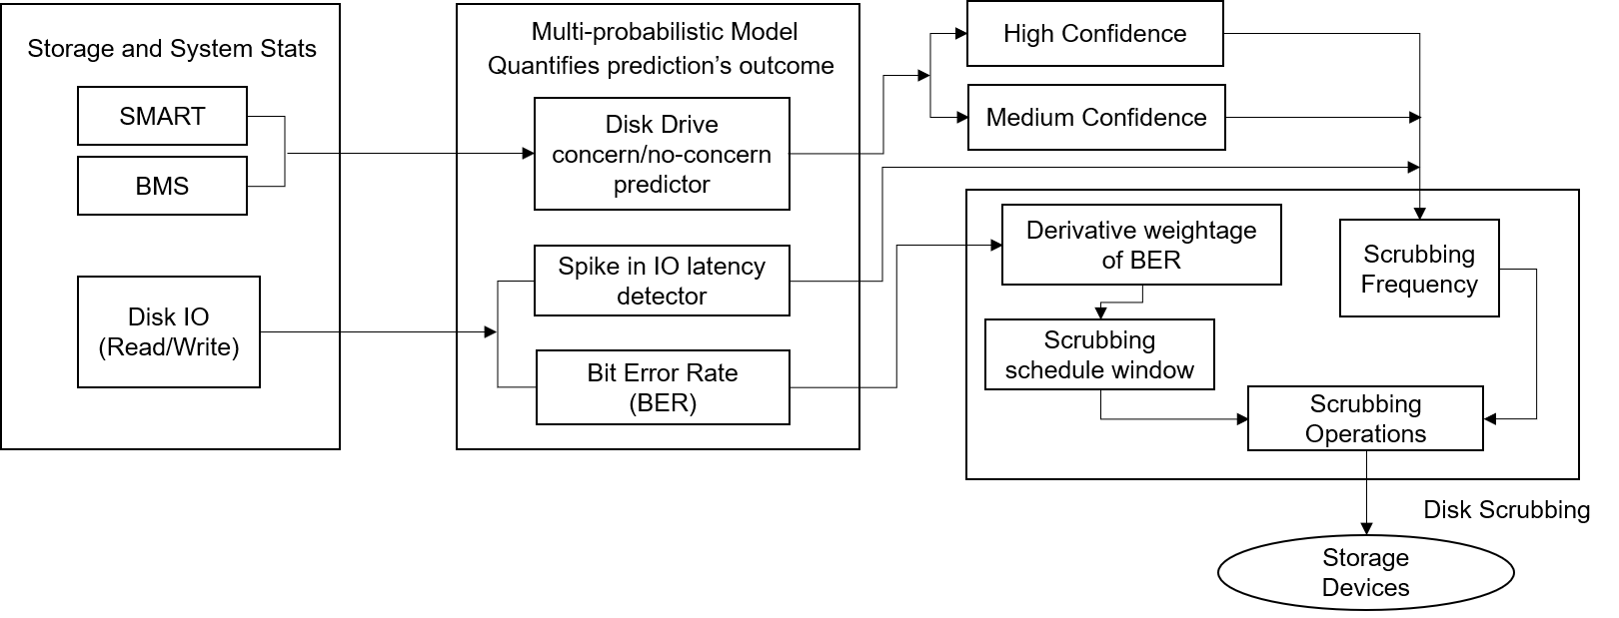
Data Scrubbing
Selective scrubbing
Identify which disk to scrub and when to scrub – implementing conformal prediction framework

Slide 24
Extended Use Case
Risk aware anomaly detection
In a risk sensitive system - business can’t tolerate even 0.001% of wrong prediction
Predictive maintenance
Adaptive key-rotation

Slide 25
Contributing to Storage Community

Slide 26
Conclusion
Machine Learning is not domain-agnostic
There is no silver bullet framework
Potential actions which can refine and complement the model:
Uncertainty Quantification
Interpretability
Explainability

Slide 27
Please take a moment to rate this session.
Your feedback is important to us.

